Slide 1
Software Design Patterns

Slide 2
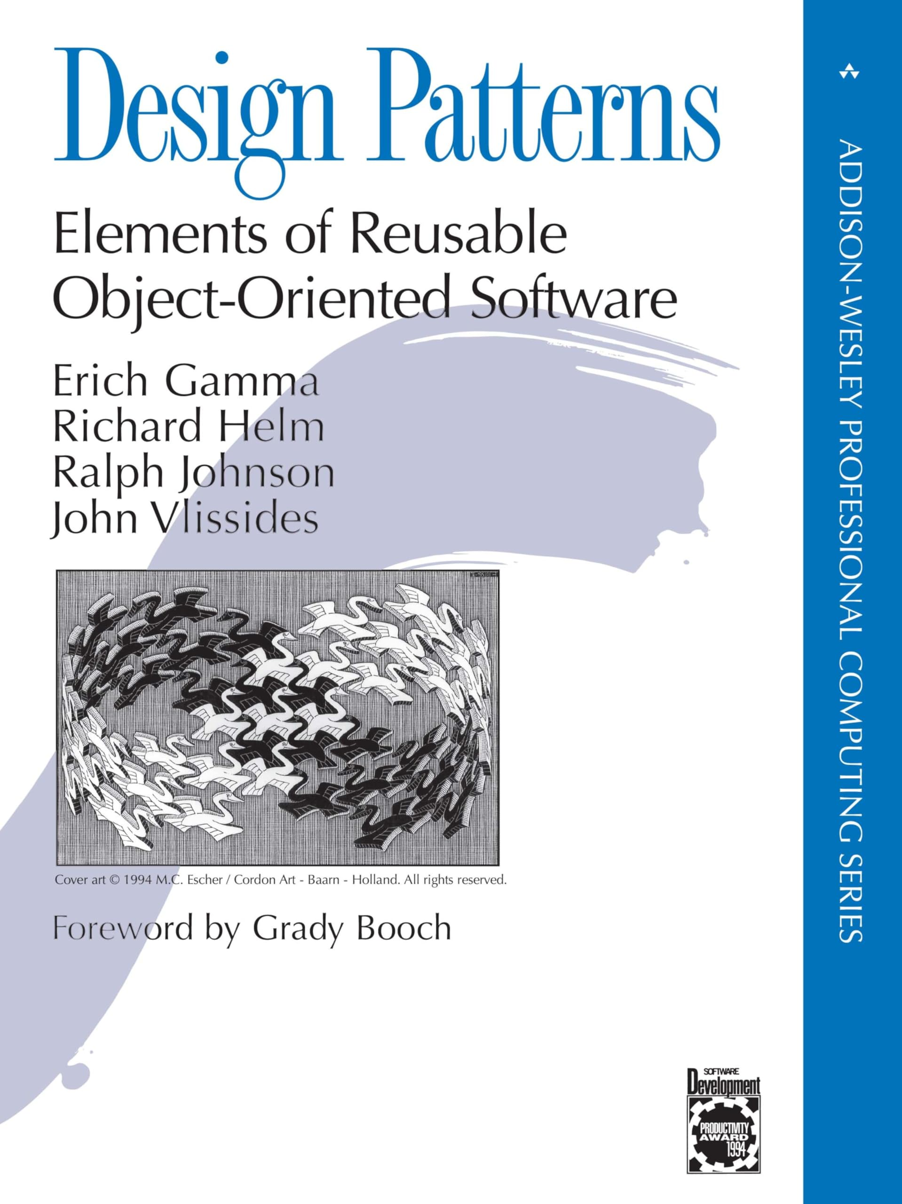
What are design patterns anyway?
1994
“Design patterns are proven, reusable solutions to common problems in software design. They help create flexible, maintainable, and scalable code by offering best practices for structuring and organizing software.”
A common theme among design patterns is their preference for composition over multiple inheritance
Notes:
While historically common in OOP, the concept of “coding pattern” has been expanded to other programming fields

Slide 3

I don’t need patterns, I have Cursor!
Notes:
Even though AI-assisted coding is very strong, programming is not only writing code, it still has a big human factor and also, current LLMs, while they know software patterns better than anyone, they don’t know the full picture of your product, so a good architecture and good coding practices are more important than ever, to properly guide these models

Slide 4
What does a pattern consist of?
Most patterns are described very formally so people can reproduce them in many contexts
A pattern consists of:
Intent, describing both the problem and the solution
Diagram (e.g., UML), showing how each part of the pattern are related
Code example, making it easier to understand

Slide 5
Classification of patterns
Traditional design patterns are usually categorized in three main groups:
Creational patterns
Structural patterns
Behavioral patterns

Slide 6
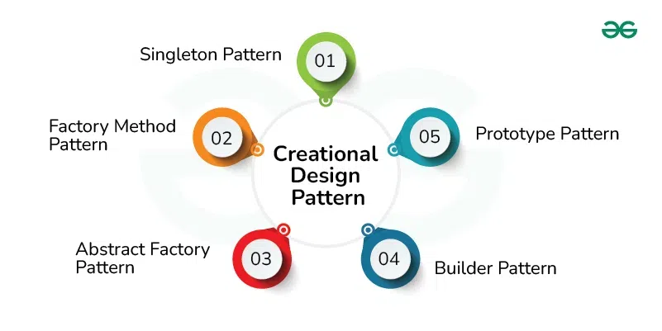
Creational Design Patterns
How to create objects in a flexible and reusable way

Slide 7
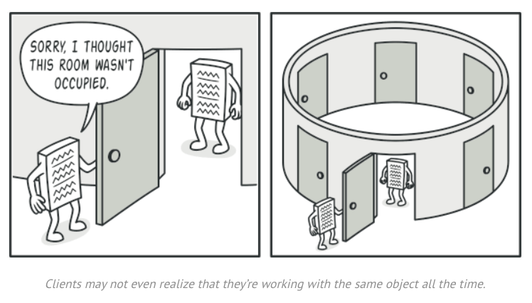
Singleton
Ensure that a class has only one instance and it is globally accessible
Image from https://refactoring.guru/design-patterns/singleton
Notes:
This pattern applies for when we need to interact with global variables that we don’t want to be overwritten by mistake using the constructor. These would probably be initialized at the start of an application.
Logger is the traditional example
Something similar to AilySettings could apply here too
Finally, we start with a singleton and then build more complex stuff on top

Slide 8
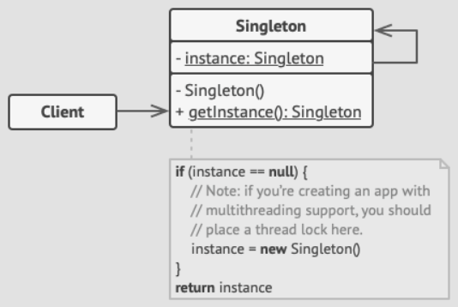
Singleton
Ensure that a class has only one instance and it is globally accessible
Image from https://refactoring.guru/design-patterns/singleton

Slide 9
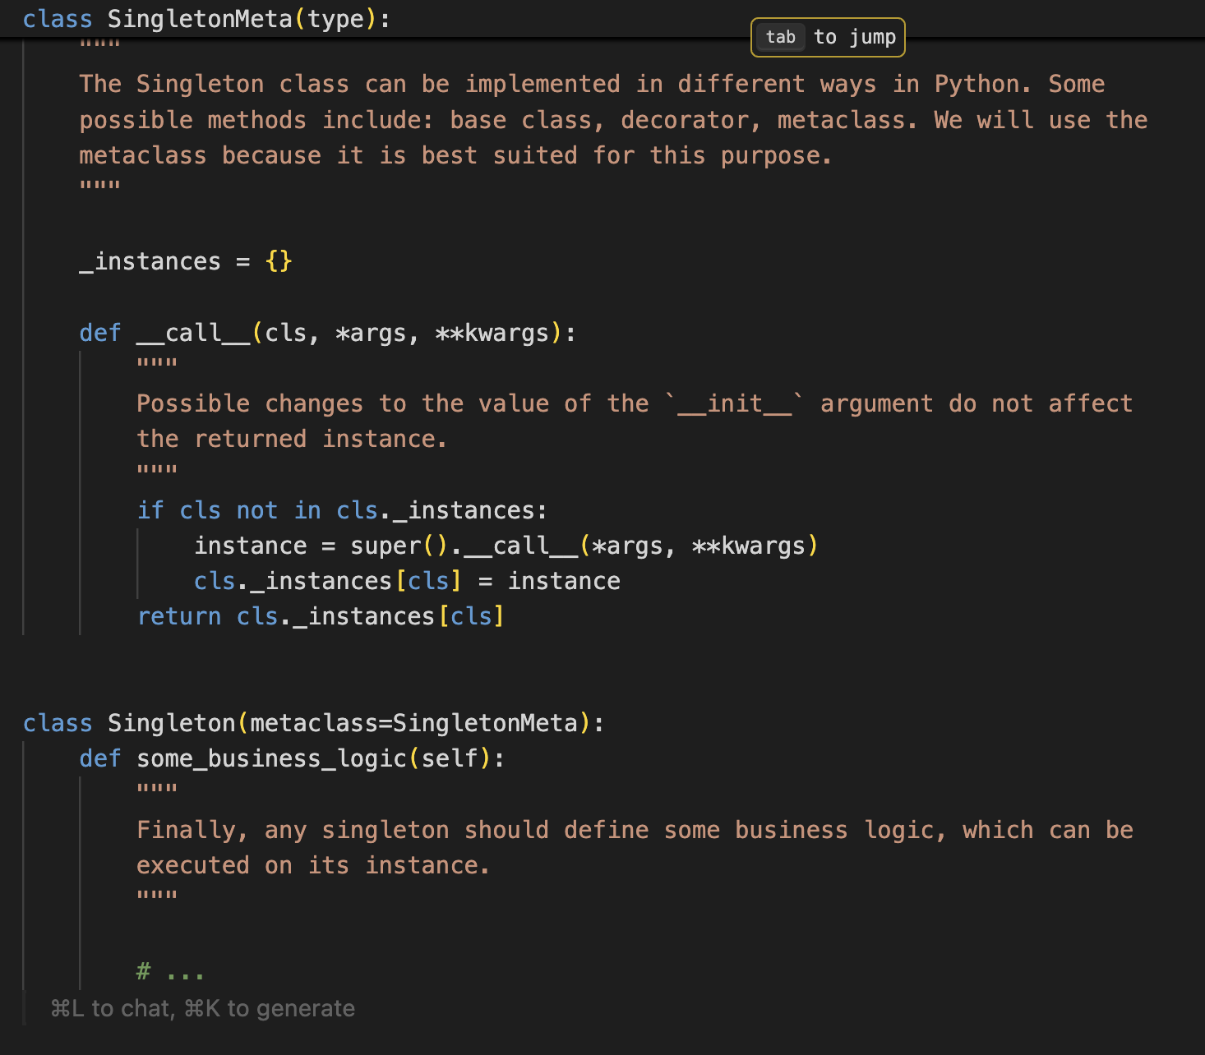
Singleton
Ensure that a class has only one instance and it is globally accessible
https://realpython.com/python-metaclasses/

Slide 10
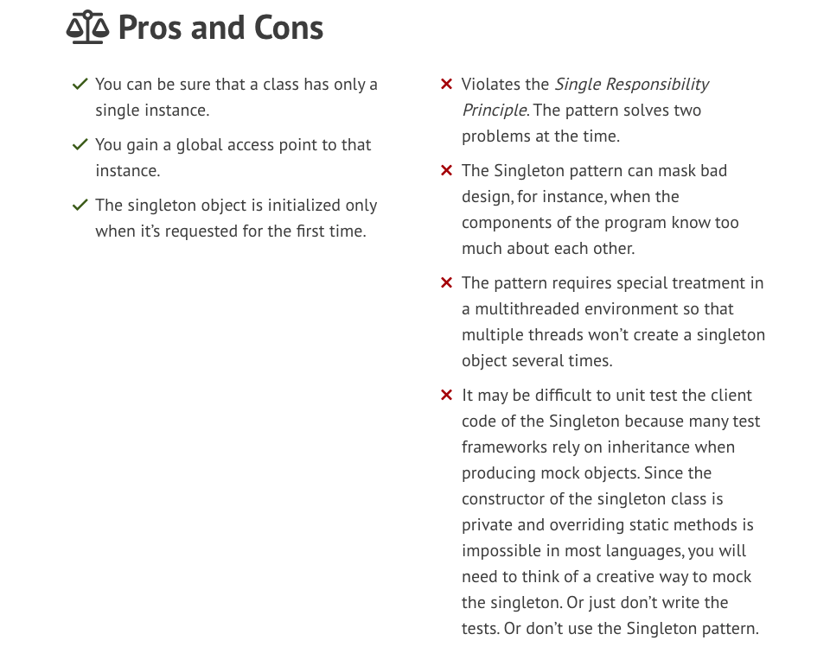
Singleton
Ensure that a class has only one instance and it is globally accessible
Image from https://refactoring.guru/design-patterns/singleton

Slide 11
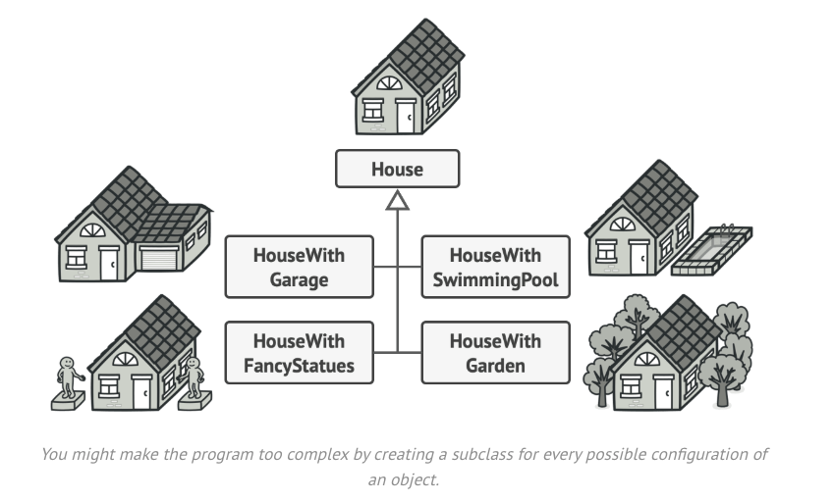
Builder
Construct complex objects step by step
Image from https://refactoring.guru/design-patterns/builder

Slide 12
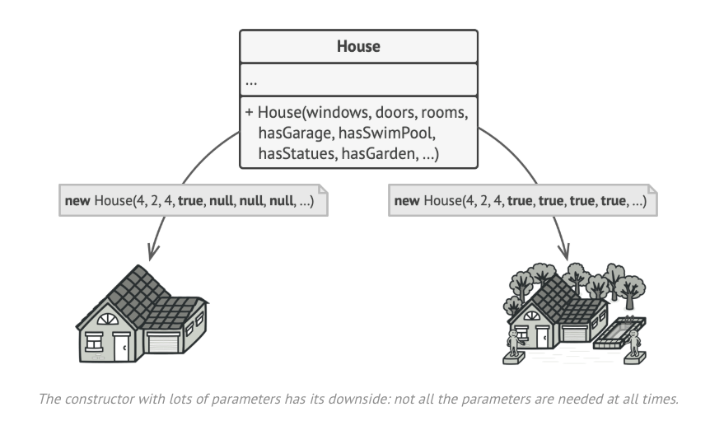
Builder
Construct complex objects step by step
Image from https://refactoring.guru/design-patterns/builder

Slide 13
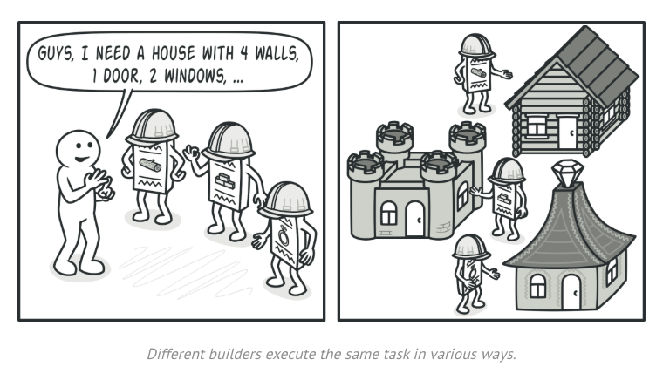
Builder
Construct complex objects step by step
Image from https://refactoring.guru/design-patterns/builder

Slide 14
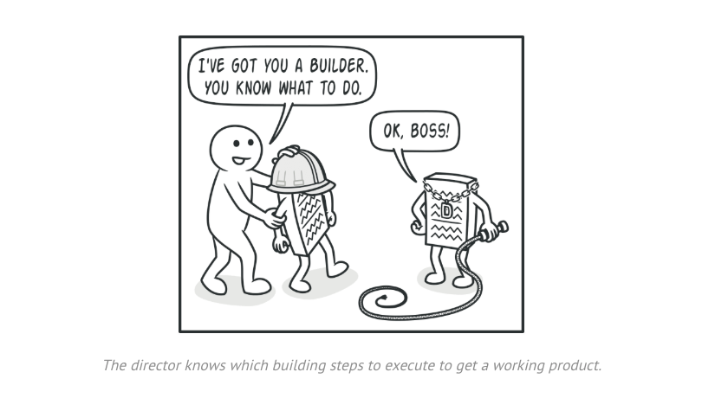
Builder
Construct complex objects step by step
Image from https://refactoring.guru/design-patterns/builder

Slide 15
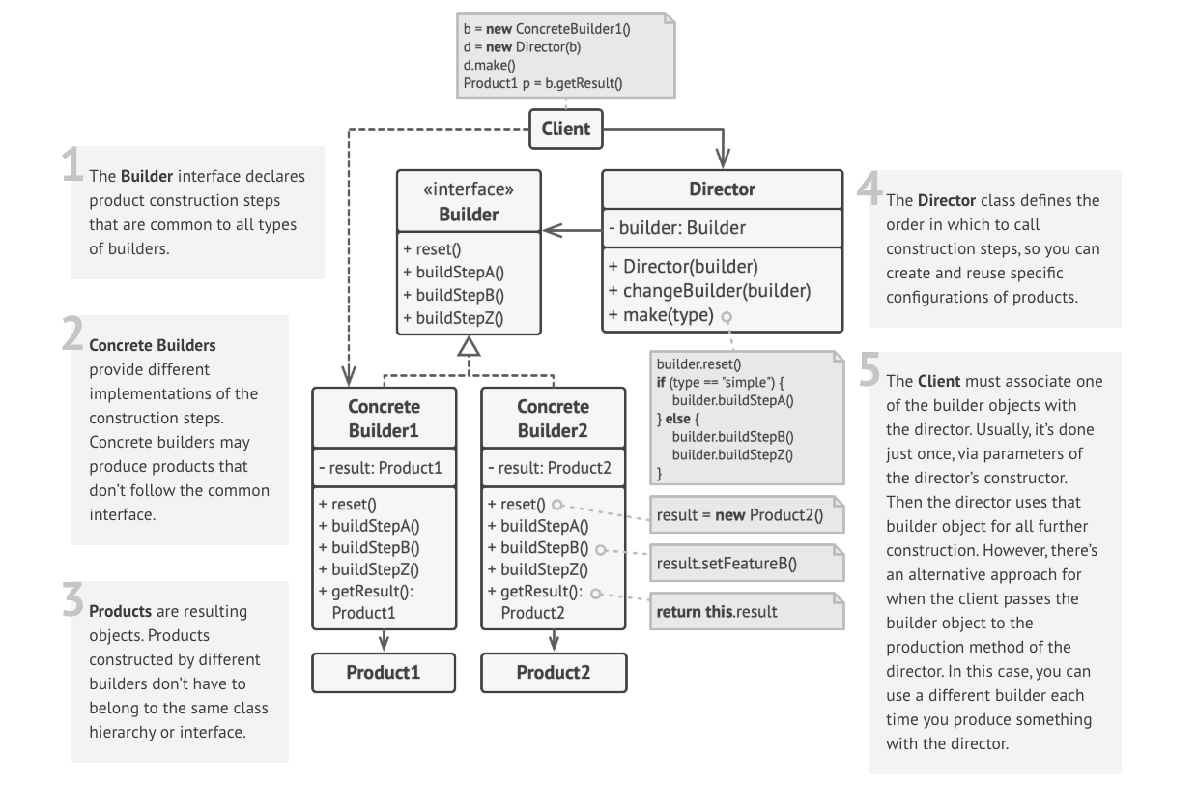
Builder
Ensure that a class has only one instance and it is globally accessible
Image from https://refactoring.guru/design-patterns/builder

Slide 16
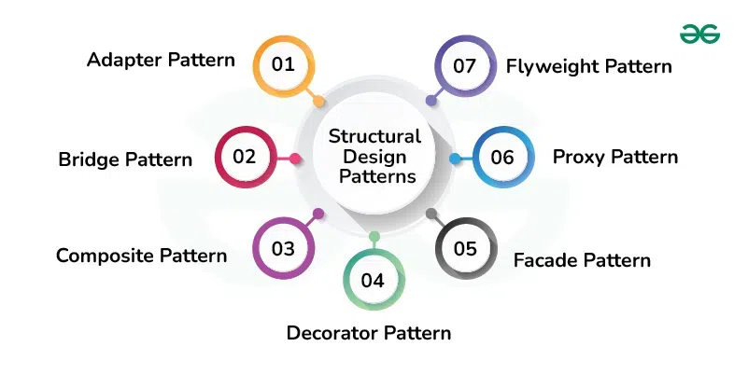
Structural Design Patterns
How to assemble objects and classes into larger structures

Slide 17
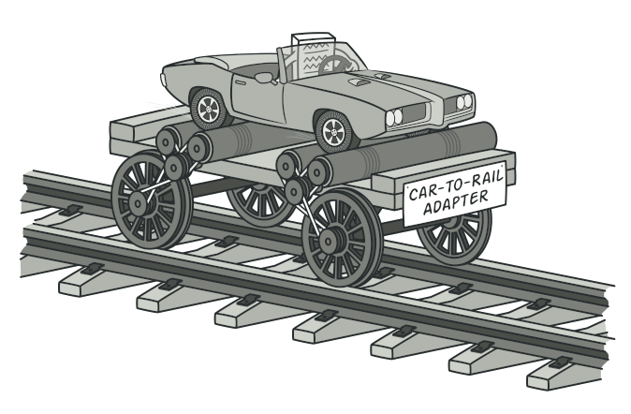
Adapter
Allow objects with incompatible interfaces to collaborate
Image from https://refactoring.guru/design-patterns/adapter

Slide 18
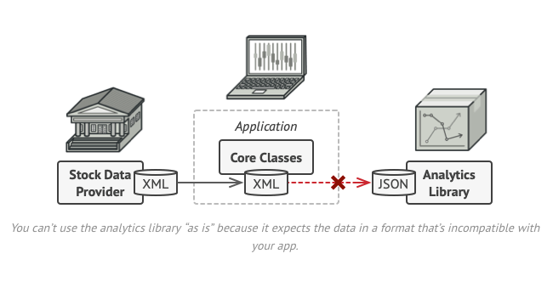
Adapter
Allow objects with incompatible interfaces to collaborate
Image from https://refactoring.guru/design-patterns/adapter

Slide 19
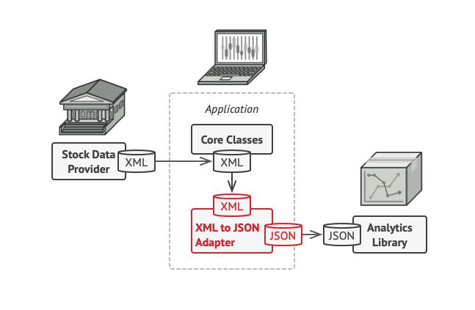
Adapter
Allow objects with incompatible interfaces to collaborate
Image from https://refactoring.guru/design-patterns/adapter

Slide 20
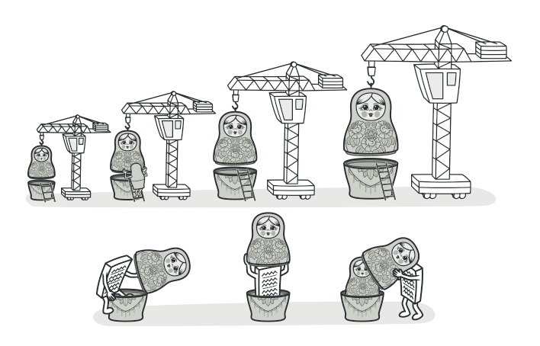
Decorator
Attach new behaviors to objects by placing these objects inside wrapper objects
Image from https://refactoring.guru/design-patterns/decorator
Notes:
A clear composition over inheritance case

Slide 21
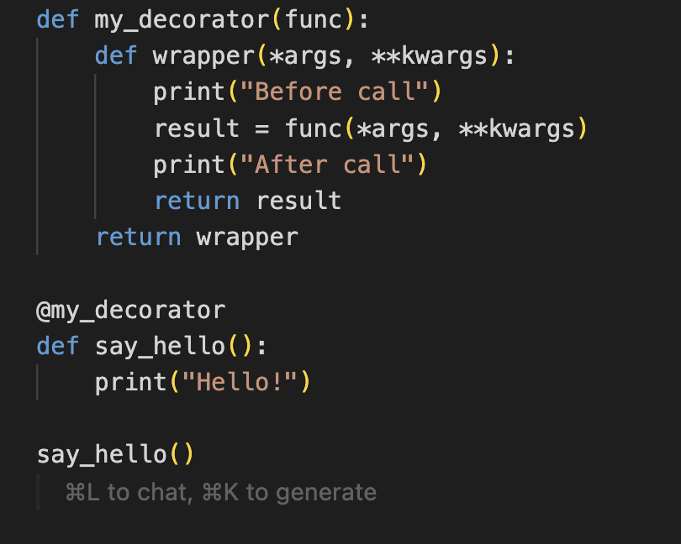
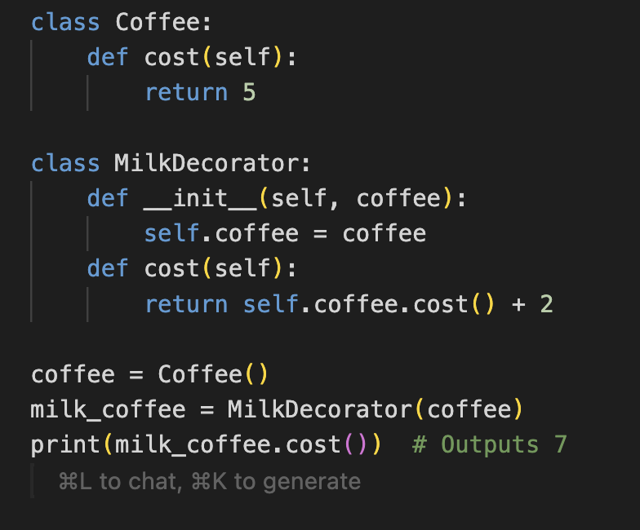
Decorator
Attach new behaviors to objects by placing these objects inside wrapper objects
In Python, functions are first class objects
Notes:
A clear composition over inheritance case
The Decorator idea is quite “native” to Python

Slide 22
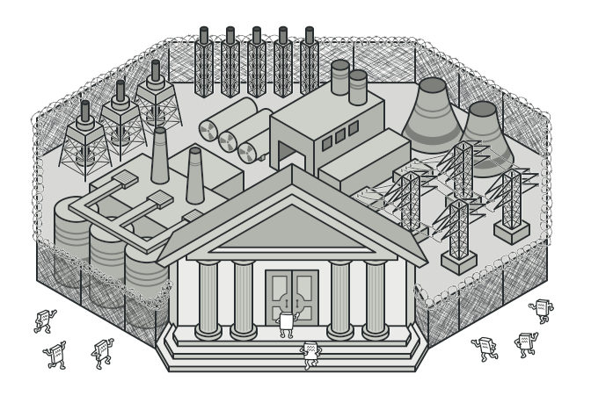
Façade
Provide a simplified interface to a library, a framework, or any other complex set of classes
Image from https://refactoring.guru/design-patterns/facade
Notes:
Instead of making your code work with dozens of the framework classes directly, you create a facade class which encapsulates that functionality and hides it from the rest of the code. This structure also helps you to minimize the effort of upgrading to future versions of the framework or replacing it with another one. The only thing you’d need to change in your app would be the implementation of the facade’s methods.

Slide 23
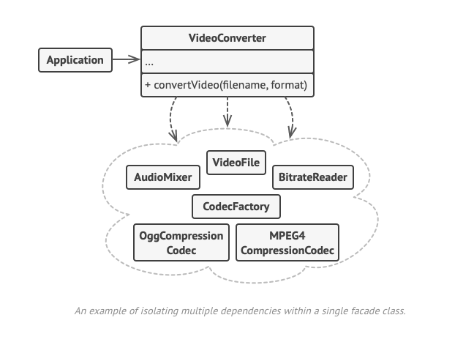
Façade
Provide a simplified interface to a library, a framework, or any other complex set of classes
Image from https://refactoring.guru/design-patterns/facade
Notes:
Instead of making your code work with dozens of the framework classes directly, you create a facade class which encapsulates that functionality and hides it from the rest of the code. This structure also helps you to minimize the effort of upgrading to future versions of the framework or replacing it with another one. The only thing you’d need to change in your app would be the implementation of the facade’s methods.

Slide 24
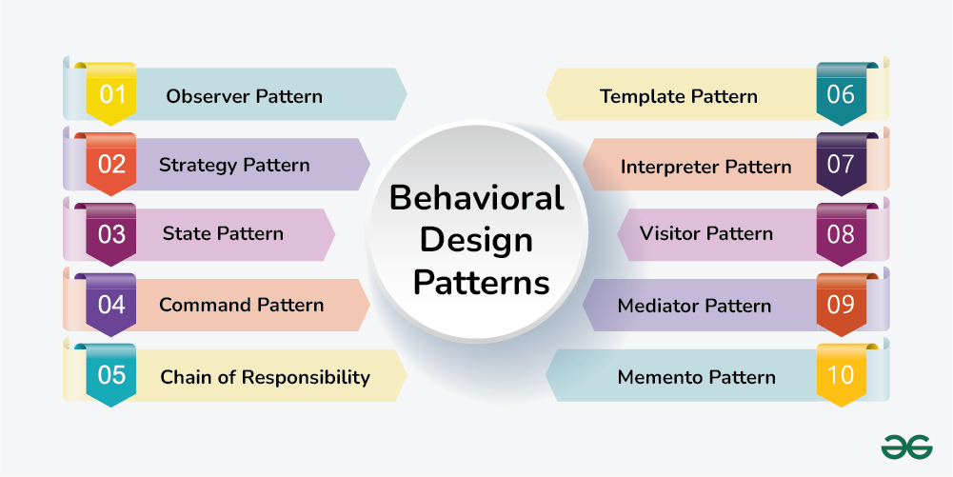
Behavioral Design Patterns
How to distribute responsibility among objects

Slide 25
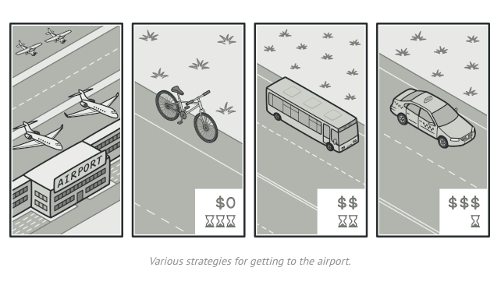
Strategy
Define a family of algorithms, put each one in a class and make their objects interchangeable
Image from https://refactoring.guru/design-patterns/strategy
Notes:
Dynamically change strategies.

Slide 26
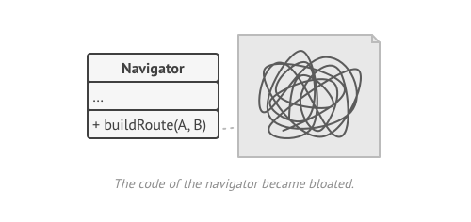
Strategy
Define a family of algorithms, put each one in a class and make their objects interchangeable
Image from https://refactoring.guru/design-patterns/strategy

Slide 27
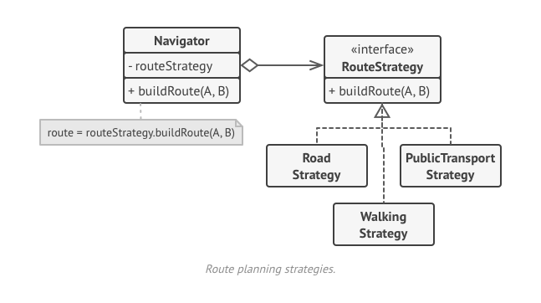
Strategy
Define a family of algorithms, put each one in a class and make their objects interchangeable
Image from https://refactoring.guru/design-patterns/strategy

Slide 28
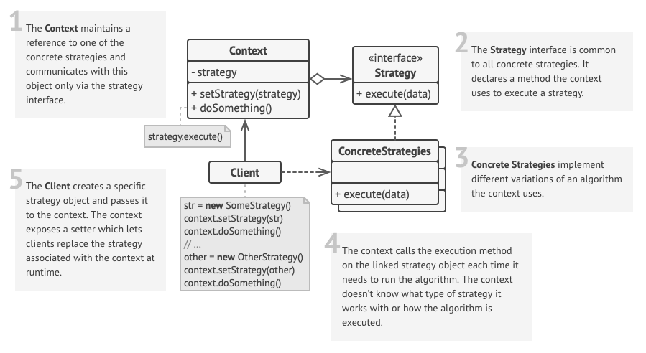
Strategy
Define a family of algorithms, put each one in a class and make their objects interchangeable
Image from https://refactoring.guru/design-patterns/strategy

Slide 29

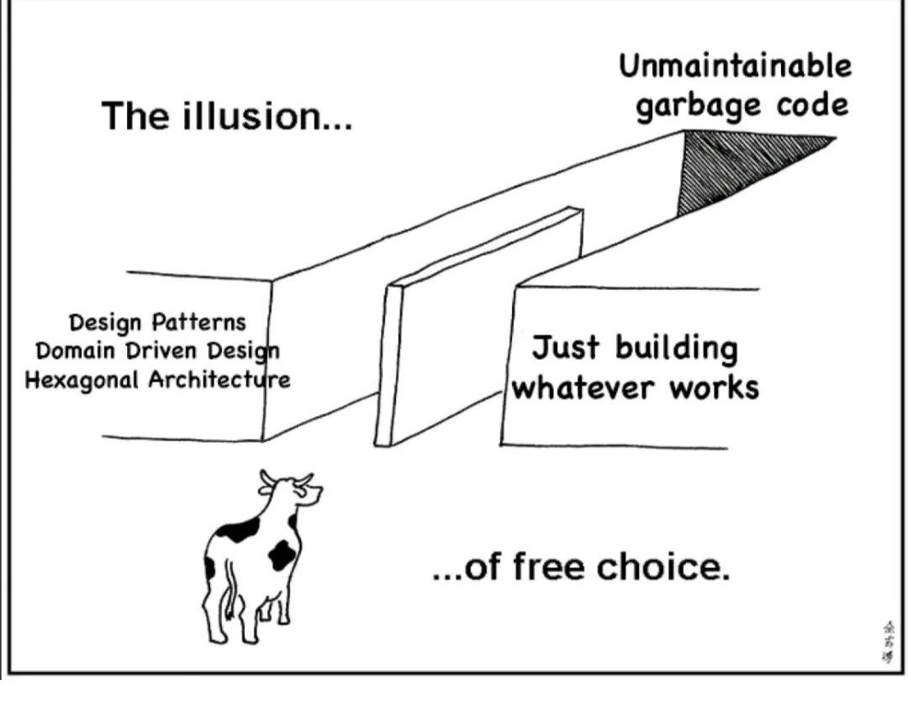
A Word of Caution
Patterns are not the Panacea
Patterns + Common Sense + Proper Documentation = Dream Solution?
Notes:
Design patterns can lead to unnecessary complexity (especially in small projects)
Sometimes developers follow design patterns religiously without understanding the real problem or alternative solutions.
This leads to boilerplate-heavy, inflexible code.
The intention of the pattern gets lost.
Some argue that design patterns exist mainly to patch the limitations of older programming languages. There is some truth there, some of these ideas have been integrated in languages, like the Strategy pattern, which can sometimes be replaced by higher-order functions in functional languages.

Slide 30



Where to learn more?
https://refactoring.guru/design-patterns
https://www.geeksforgeeks.org/software-design-patterns/

Slide 31
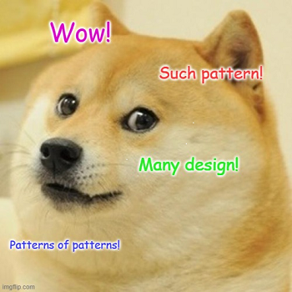
Thank you

